Slide 1
Content Services
Focus Area: Back-end

Slide 2
Training Overview
Group Workshop
Back-end
Front-end
Services
Integration
Content
Services
Advanced
Security
Overview
Widget Development
Template
Development
Targeting
Publishing
Portal Client
ICE
Foundation
Portal Essentials
Portal Technologies
Portal Tools
Portal APIs

Slide 3
Objectives
Content Services Repositories
Learn how to work with the different interfaces
Learn how to customize content services
Content Service Importers and Validators
Integrate content services with portal foundation

Slide 4
Content Services
Content Services

Slide 5
Content Services
Content Services is a content delivery platform provided as a Backbase CXP optional module
Content Services provides a centralized Content Repository
Main functions:
Stores “In Context Editing” (a.k.a. ICE) content from CXP Manager.
Stores reusable content (potentially harvested through importers from remote sources).
Stores configuration data and resources.

Slide 6
CS vs. CMS
Content Management System (CMS)
Channel independent content assets (content items)
Advanced content lifecycle management (versioning/workflow)
Provides management of reusable content
Content Services (CS)
Centralized Content Repository, ready for delivery
User generated content
Content harvested from different sources
CXP Manager / Page editor
Channel specific, page creation
In context page editing (create or add content)

Slide 7
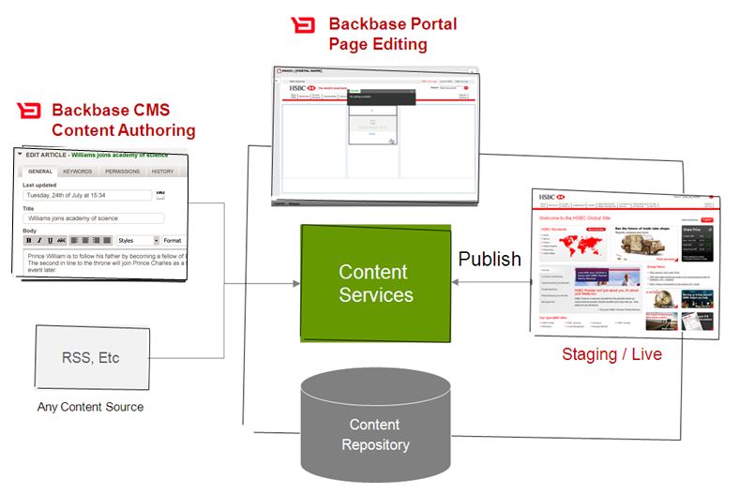
CMS + Page Editing
CONTENT Authoring
PAGE Editing
VISITORS
CONTENT authoring
PAGE Editing
VISITORS
(Existing CMS)
(Existing CMS)
CMS
Authoring GUI
CMIS
interface
1
staging / live
CMS Content
Repository
Read only
CMS Live Content
Repository
2

Slide 8
CMS + Portal Content Services + Page Editing
CONTENT Authoring
PAGE Editing
VISITORS
CONTENT authoring
PAGE Editing
VISITORS
(Existing CMS)
(Existing CMS)
CMS
Authoring GUI
CMIS
interface
2
staging / live
2
CMS Content
Repository
CMIS interface
CMIS interface
Portal
Content
Repository
Portal Content
Repository
1
Import
Import

Slide 9
Kinds of Content Used in Portal Pages
There are two kinds of content that may appear in portal pages:
In-Context Editing (ICE) content — rich text inserted during page management. ICE Content is published implicitly as part of the page in which it resides. ICE Content is stored automatically and is not manageable.
Reusable Content — content items that can be used across different pages of the same or different portals. Reusable Content is uploaded, managed and published centrally in the Shared Content and Portal Content apps and can be referenced in pages.
Simple — uploaded media type files which can be directly referenced in pages, such as images, videos, PDFs, etc.
Structured — instances of custom Structured Content types.

Slide 10
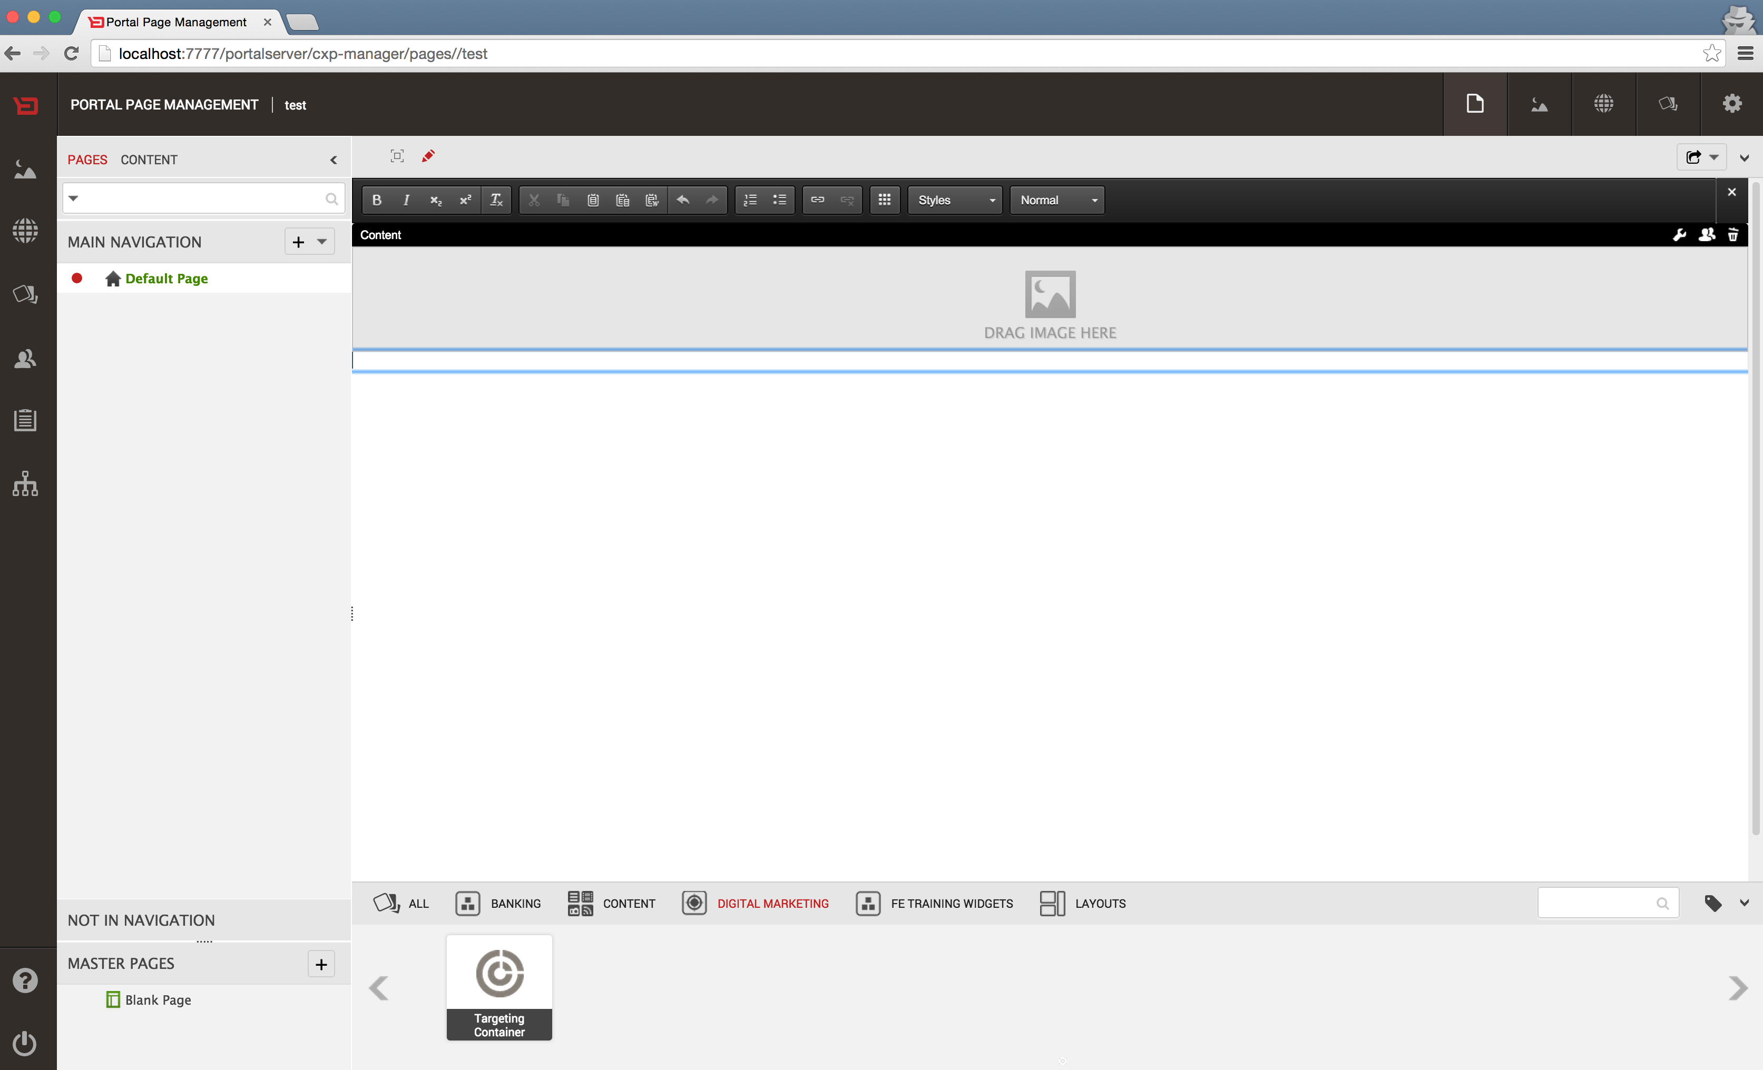
In Content Editing (I.C.E.)
Stores “In Context Editing” (a.k.a. ICE) content from portal manager.

Slide 11
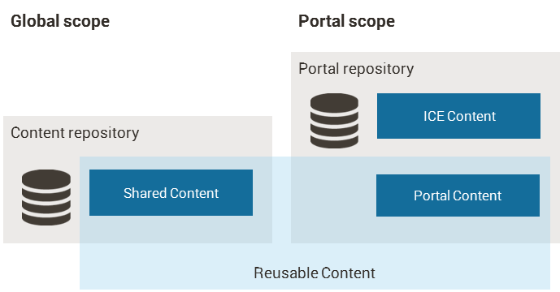
Scope of Reusable Content
Regarding scope, reusable content can be:
Shared (or global)
Portal-specific
Notes:
Regarding scope, Reusable Content can be:
Shared (or Global) — content items which are shared and stored in the content repository. Shared Content items are managed from the Shared Content app and are available to be dragged and dropped in pages of all portals in your environment.
Portal-specific — each portal has their own repository, the portal repository, that stores Portal Content (and ICE Content). Portal Content items are managed from the Portal Content app and are visible only for users of that portal; so only available to drag and drop on pages of that portal.

Slide 12
Content Harvest
Content
Services
CMS
(CMIS compatible)
RSS Feeds
Cloud Service

Slide 13

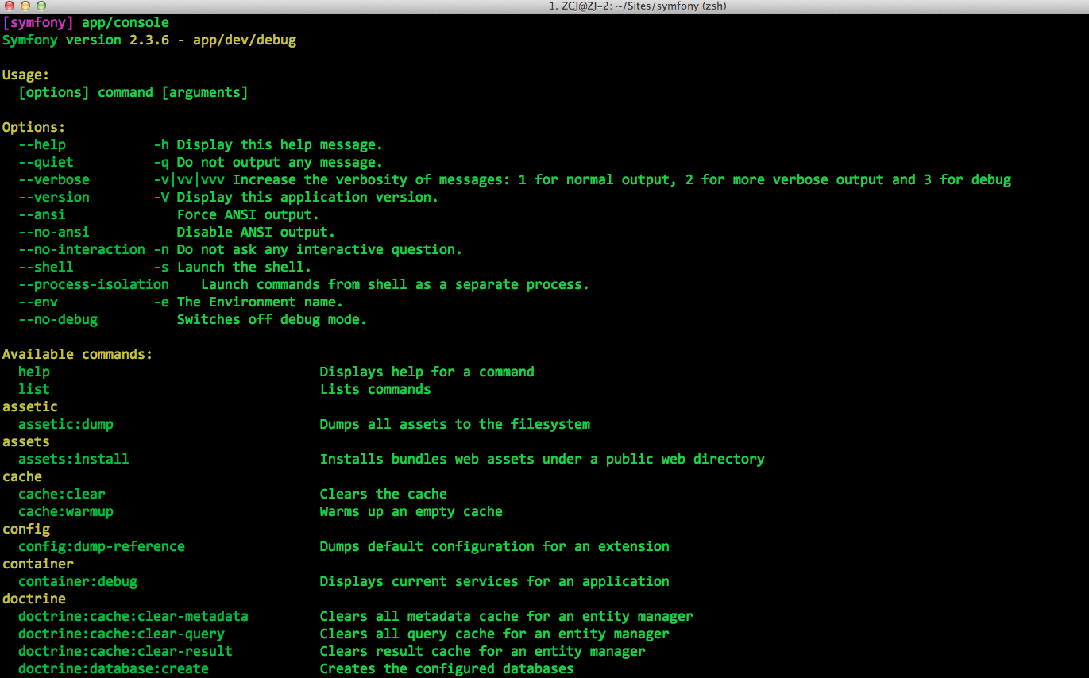
Content Services - Architecture
Server
Backbase CXP Foundation
Remote
Application
Content Services
CMIS
Repositories
WebDAV
Content
Portal
JMX
File System
Portal
Portal
Configuration
Resources
Importers
Remote Content
Notes:
Content repositories - These repositories store content used by Backbase widgets, like images and text.
Content repository — stores Shared Content that multiple portals can use. One can navigate this repository from the Shared Content app in CXP Manager.
Portal repositories — each portal has its own repository that stores ICE Content and Portal Content. One can navigate this repository from the Portal Content app in CXP Manager.
Internal repositories
Configuration repository — allows to configure importers that fetch remote content.
Resources repository — stores imported catalog items (when Import/Export is configured to store imported catalog items in Content Services).

Slide 14
Content Services - Repositories
Content Services consists of the following repositories:
Content - a repository for storing reusable (web) content shared between all portal instances
Each portal instance has its own Portal repository that stores ICE and reusable content specific to that portal
Configuration - a repository for storing importer configurations
Resources - a repository for storing Backbase CXP resources

Slide 15
Content and Portal Repositories
Store reusable web content
Can be imported from remote sources (3th party CMIS, Feeds)
Can store user generated content (ICE)

Slide 16
Configuration Repository
Stores the relevant Content Services configuration files
RSS and Atom Feed import configuration
CMIS import configuration
Create a properties file and import the configuration
You can add, edit or remove configurations at runtime

Slide 17
Resources Repository
Stores resources needed by Backbase CXP:
Javascript
CSS
Images
XSLT files
Version history
…

Slide 18
Exercise: Start Content Services
Start portal server (do an import if necessary)
Start content services
Change into the content services directory
Use jetty:run-war
Try to add content via portal manager’s content widgets

Slide 19
Interfaces
Content Services

Slide 20
Content Services - Interfaces
Interfaces to interact with the Content Services repositories:
CMIS - enables interaction with any of the three repositories (Content, Configuration and Resources) at a very low level, down to metadata.
WebDAV - batch processing capabilities make the WebDAV interface suited to run batch jobs on the Content repository.
JMX - manages and monitors the delivery service.

Slide 21
CMIS
Content Services / Interfaces

Slide 22
CMIS
CMIS stands for Content Management Interoperability Services
CMIS is an OASIS standard designed for the ECM (Enterprise Content Management) industry.
Examples of CMSs that implement the CMIS standard include: Backbase CMS, Microsoft SharePoint, IBM FileNet, ECM Documentum, and Alfresco.
CMIS specifies a query language based on SQL-92.
It is read only and has limited support for joins.
Depending on the repository, it can do both full-text and metadata based queries.
Backbase Content Services Repository implements a subset of the CMIS specification.

Slide 23
CMIS – Key Concepts
Web Services and ReSTful AtomPub
Repository
Basic Objects Types
Document (cmis:document)
Folder (cmis:folder)
Relationship (cmis:relationship)
Policy (cmis:policy)
Notes:
http://docs.oasis-open.org/cmis/CMIS/v1.0/os/cmis-spec-v1.0.html

Slide 24
CMIS - Document
cmis:document
Represents pieces of content in the repository, like images, text or CSS
Lookup using ID or path
Document object may have content streams.

Slide 25
CMIS - Folder
cmis:folder
Represents folders in the repository, capable of containing documents or other folders
Lookup using ID or path
Can only have one parent
One-to-many relationship with cms:document

Slide 26
CMIS – Custom Object Types
bb:link - extends cmis:document, used to store hyper-links
adds the bb:url and bb:title properties
bb:richtext - extends cmis:document, meant to store content for the Rich Text Editor (from ICE)
can store any textually encoded content
bb:image - extends cmis:document, used to store images
adds bb:altText, bb:height, bb:lastPublishedDate, bb:tag, bb:title and bb:width properties

Slide 27
CMIS Services
Common Service Elements
Repository Services
Navigation Services
Object Services
Multi-filing Services
Discovery Services
Versioning Services
Relationship Services
Policy Services
ACL Services

Slide 28
CMIS Query
Content Services implements a subset of the query language specified in the CMIS Standard.
SELECT * FROM cmis:document
* mean all columns
<select list> is coming in next release.

Slide 29
CMIS Predictates
SELECT * FROM cmis:document WHERE …
Comparison ( >, <, <>, >=, <=, =)
SELECT * FROM cmis:document WHERE cmis:contentStreamLength >= 1024
IN (list of values)
SELECT * FROM cmis:document WHERE cmis:objectTypeId IN ('bb:image','bb:richtext','bb:link')
LIKE (% and _ are special characters)
SELECT * FROM cmis:document WHERE cmis:name LIKE 'j%’ SELECT * FROM cmis:document WHERE cmis:name LIKE 'j___.xml'

Slide 30
CMIS Order by
Order by (ASC, DESC)
SELECT * FROM cmis:document WHERE cmis:contentStreamMimeType = 'text/xml' ORDER BY cmis:objectId
SELECT * FROM cmis:document WHERE cmis:contentStreamMimeType = 'text/xml' ORDER BY cmis:objectId DESC

Slide 31
CMIS Clients
Apache Chemistry Workbench
http://chemistry.apache.org/java/download.html
Apache Chemistry Java API
Backbase JavaScript API

Slide 32
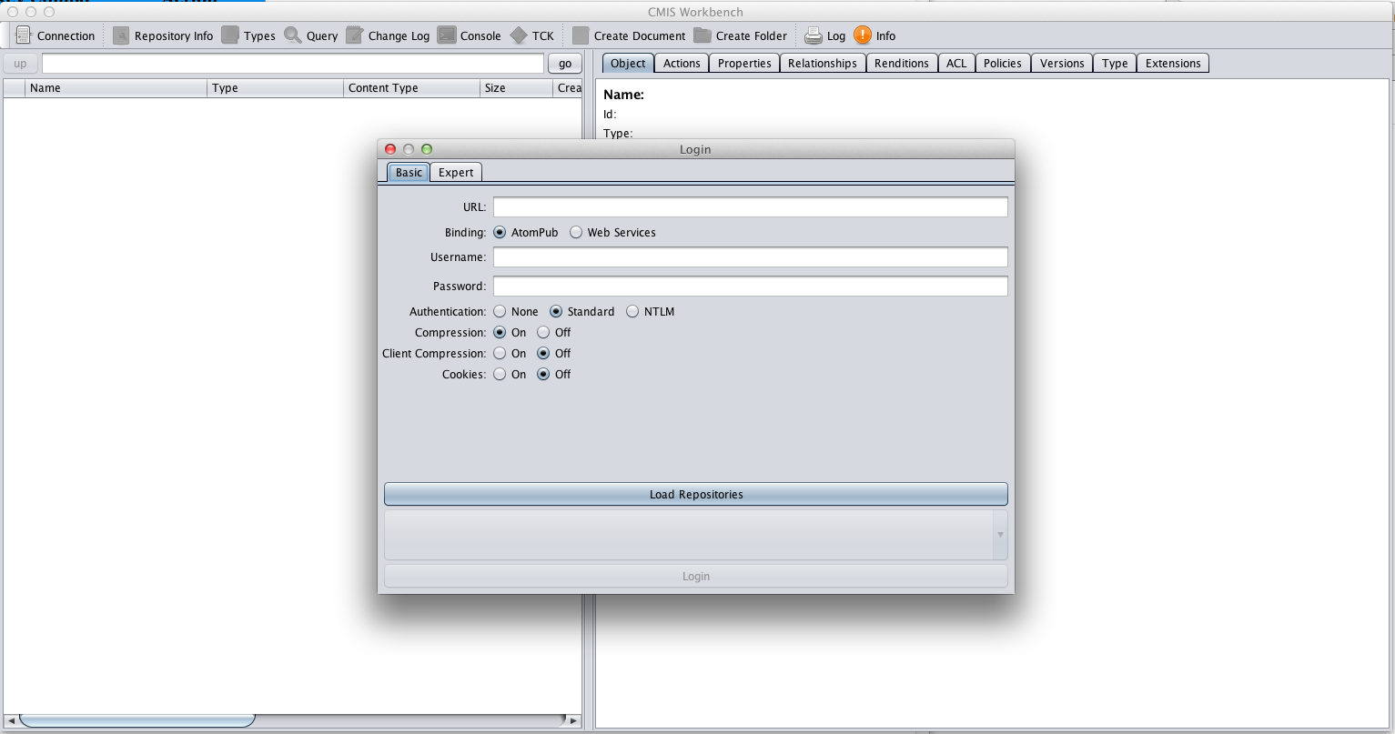
Chemistry Workbench

Slide 33
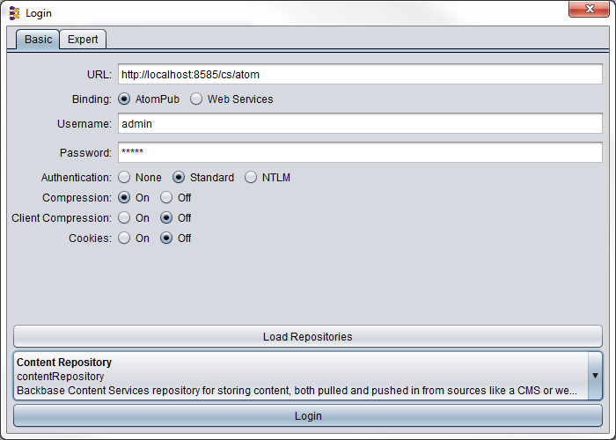
Exercise: CMIS
Starting the CMIS Workbench
Login
Add folders and documents
Fire some queries
Notes:
http://localhost:8082/contentservices/atom (Content Repository)
Properties tab
Actions tab
Query (SELECT * FROM cmis:document WHERE cmis:objectTypeId='bb:image')

Slide 34
CMIS Java API
Possible to connect to a repository programmatically.
Using Apache Chemistry CMIS Java API.
The same functionality that exist in CMIS clients is possible using the Java API.
Comprehensive example available as a How To guide on my.backbase.com under the heading “Working with Content Services from Java Using the CMIS API”

Slide 35
CMIS Java API
CMIS session – A connection to a CMIS repository with a specific user Map<String, String> connProps = new HashMap<>(); connProps.put(SessionParameter.ATOMPUB_URL, “http://localhost:7777/portalserver/content/atom”); connProps.put(SessionParameter.USER, “admin”); ... SessionFactory factory = SessionFactoryImpl.newInstance(); Session session = factory.createSession(cmisConnectionProperties); ... Document doc = (Document) session.getObjectByPath(“/img/pic.jpg”); ... QueryStatement qs = session.createQueryStatement("SELECT * FROM cmis:document”);
Sessions are purely a client side concept: thread-safe, closing not required. Results cached by default.

Slide 36
Exercise: CMIS Java API
Create a Camel route listening for file changes in a folder
Path configurable in backbase.properties
Assume flat file structure
Handle updates to existing files
Implement the CMIS endpoint as a Spring bean and invoke it using Camel’s bean binding
Create an endpoint (Spring bean) that returns the MIME type of a file
Use this route to enrich the content of each message (Content Enricher EIP )
(OPTIONAL) Handle full folder hierarchy

Slide 37
WEBDAV
Content Services / Interfaces

Slide 38
WEBDAV
http://host:port/applicationcontext/webdav/repositoryname
Repositories
contentRepository
configurationRepository
resourcesRepository
Bulk Import
Disabled by default. To enable it, set contentservices.repository.webdav.enabled=true

Slide 39
WEBDAV Clients
Mount with Microsoft Window Exporer
Mount in Finder (OSX)
BitKinex (Windows)
Cyberduck (OSX)
Kadaver (OSX)
FuseDav (GNU/Linux)
DavFS2 (GNU/Linux)

Slide 40
JMX
Content Services / Interfaces

Slide 41
JMX in Content Services
JMX – Java Management Extensions
“Dig” into runnning application and change it on a fly
Instrument applications for management, monitoring and configuration
JMX clients
jConsole (part of sun JDK)
jManage

Slide 42
MBEANS
MBean – a JavaBean that exposes certain methods which define the management interface
Available Content Service MBeans
EHCache (objects caching management)
Hibernate (database caching management)
Logback (log configuration management)

Slide 43
EHCACHE MBEAN
Exposes configuration parameters
timeToLiveSeconds,
timeToIdleSeconds,
maxEntriesLocalHeap,
maxEntriesLocalDisk and
memory-store eviction policy
Also gives access to statistics about cache hits and misses, cache usage and memory management

Slide 44
Hibernate MBEAN
Exposes statistics about:
the number of open and closed sessions,
cache usage,
CRUD operations
executed queries

Slide 45
Logback MBEAN
Allows configuration of logback via JMX
Reconfigure logback from the default configuration file, a designated file or a URL,
List loggers
Modify logger levels

Slide 46
Importers
Content Services

Slide 47
Importers
Used to retrieve external content
Regularly checks for new content
Configuration in the configuration repository
Dynamic: add, edit or remove configurations at runtime
Schedule (cron) jobs
Enable scheduler in the backbase.properties file:
repository.scheduler.enabled=true

Slide 48
Default Importers
RSS and Atom Importer
Configured in the importers/feed folder of content services
CMIS Importer
Config in the importers/cmis folder of content services
Note: Imported items are overwritten

Slide 49
Configure Importer
Enable scheduled jobs in content services
Access the content repository and create the target folder
Create new import configuration
Create new job configuration (quartz)
Access the configuration repository and upload the two configuration files in the appropriate folders

Slide 50
RSS and Atom Feeds Configuration
configurationRepository
/importers/feed
id=currencyRatesFeed
group=feedgroup
description=Forex RSS feed
targetRepositoryId=contentRepository
targetFolderPath=/myfeeds
remoteLocation=http://themoneyconverter.com/rss-feed/EUR/rss.xml
defaultEncoding=utf-8

Slide 51
Importer Job
configurationRepository
/scheduler/jobs
#runs the importer every 60 seconds
id=currencyRatesJob
jobGroup=feedgroup
cron=0/60 * * * * ?

Slide 52
CMIS Importer Configuration
configurationRepository
/importers/cmis
id=myCmisImporter
group=cmisgroup
description=optional_description
sourceCmisLocation=http://localhost:7070/contentservices-webapp/atom
sourceCmisRepositoryId=contentRepository
sourceCmisFolderPath=/cmisImporterTestFolder
targetCmisLocation=http://localhost:7070/contentservices-webapp/atom
targetCmisRepositoryId=contentRepository
targetCmisFolderPath=/CS_TEST_FOLDER
userName=user_name
password=password
defaultEncoding=utf-8

Slide 53
Exercise: Import
Import the Money Converter’s RSS currency feed:
http://themoneyconverter.com/rss-feed/EUR/rss.xml
Use online documentation
Tips:
/importers/feed/ (your feed configuration files)
/scheduler/jobs/ (your job configuration files)
Notes:
http://localhost:8082/contentservices/atom (Content Repository)
Create Folder (myfeeds)
Connection (Configuration Repository)
Create Folder (importers/feed)
(Create and save feed.properties file)
Create Document (Type=cmis:document, browse for the file)
To create the job that will execute our importer, we need to create the scheduler/jobs folder, and save the job.properties file in it
Content Services will automatically start to execute this job (check if contentservices.repository.scheduler.enabled=true)
Go back to Content Repository to see the result

Slide 54
Renditions
Content Services

Slide 55
Renditions
Renditions are an alternative representations of the same document.
Examples:
the thumbnail preview of an image
the PDF version of a text document
the XSLT transformation of an XML file
Content Services creates and modifies renditions whenever a CRUD (Create, Read, Update, Delete) event occurs

Slide 56
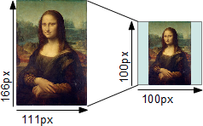
Rendition Engines
Rendition Engines in Content Services
Thumbnail
…more to come
Custom Rendition Service (Coming Soon)
RenditionEngine Interface
executeCreate()
executeUpdate()
executeDelete()
executeMove()

Slide 57
Validators
Content Services

Slide 58
Validators
Validate CRUD operations before they execute
A canceled event will cause a HTTP 500 error.
Repository
Listener
Validator
Engine
Registered
Validators
Repository Service
CRUD
Event
Calls
Validator
Engine
Calls
All Registered
Validators
Throw
Exception
CRUD
Event
Canceled
Executes CRUD operation
Returns Control
Returns Control
Cedes control to the Repository Service

Slide 59
Validators
RepositorySchemaValidator:
Checks that object complies to its type schema before a create/update operation.
Ensures that all required properties are set.
Custom validators

Slide 60
Custom Validators
Implement the RepositoryValidator interface
validateCreate()
validateDelete()
validateMove()
validateUpdateContentStream()
validateUpdateProperties()
See also the online javadoc

Slide 61
Exercise: Validators
Create a validator that will allow creating or updating images (documents of the bb:image type) only if they have one of the following extensions ".jpg", ".jpeg", ".png"

Slide 62
Deployment
Content Services

Slide 63
Deployment
Test environment jetty:run
Database setup
Application Containers

Slide 64
Caching
Content Services

Slide 65
Caching
Browser Cache
Reducing latency
Reducing network traffic
Cons: cache content can be not up to date (stale)
HTTP cache-control headers
public, private, and max-age

Slide 66


Caching
backbase.properties
contentservices.cache-control.default=public; max-age=600
Request
HTTP
headers
Client
HTTP Request
Server
HTTP Response
Response
HTTP
headers
Content

Slide 67
Versioning
Content Services

Slide 68
Versioning Services
Content Services implements part of the versioning services defined in the CMIS Standard.
The versioning services
store different versions of the same document,
reference each individual version according to the value of its properties,
make possible to track which user created a particular version.
The locking mechanism prevents concurrent changes by different users.
Only Backbase object types support versioning, while pre-defined types (like cmis:document) do not.
The Versioning feature in Backbase CXP Foundation uses CS to version pages, content items, and links.
Page versions are stored in the resources repository of CS.

Slide 69
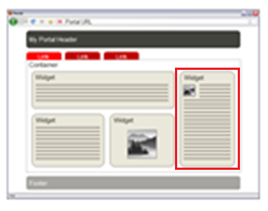
Versioning
Content Services
v 1.0
v 2.0
v 3.0
v 4.0
v 5.0
Backbase CXP

Slide 70
Version Series
A version series is a collection of objects created from an original document.
Each version series has a unique, system-assigned, and immutable ID, and its members are assigned version numbers.
Version numbers follow the syntax major.minor, and users can decide whether the version of a document is major or minor:
major version numbering starts with 1.0 and increases by 1 with each subsequent major version
minor version numbering starts with 0.1 and increases by 0.1 with each subsequent minor version
Backbase CXP uses only major version numbers.

Slide 71
Portal Integration
Content Services

Slide 72
Portal Integration
Portal Server Configuration
Specify the location of Content Services in the portal property file.
Decide content integration strategy
Client side
Server side

Slide 73
Content Consumption (Delivery)
Portal Page
Content
(X)HTML
Widget
Mashup
Services
Content
(X)HTML
Widget
g:include
Content
Services
Content
(X)HTML
CS Proxy
Widget
document URL
Existing CMS
(Tridion)
Backbase
CMS
Feed
XML / RSS
Content
Services
Mashup
Services
CMIS
XHTML
Widget
JSP tag
Content
XML
Notes:
1 used e.g. with the Mustache data provider
2 you can use the path contentservices/cache to e.g. iterate over news in a news feed
3 the same as the first one

Slide 74
Content Consumption (Delivery)
Client side
Widget g:include + mashup services
Server side
Create your custom CMIS tag library in JSP
Create your custom extension for other templating technologies.
Tip: Apache Chemistry CMIS Client

Slide 75
Exercises
Content Services

Slide 76
Optional Workshop: Portal Integration
Create a data provider in the portal to connect to content services and retrieve Forex data (use Apache Chemistry OpenCMIS)
Use XSLTTransformer to convert content services XML to HTML
Configure a pipe in ptc-config.xml
Test the application
Optionally, create a widget to display the relevant data
Notes:
Prerequisite: remember to complete the previous exercise on feed importers in order to have data in the contentRepository needed for this exercise.
All the relevant classes for this exercise are in the training bundle.
Dataprovider: com.backbase.exercises.ptc.dataproviders. CurrencyRatesDataprovider
XSL Stylesheet: \src\main\webapp\WEB-INF\xslt\currencies\currencies.xsl
Widget: \src\main\webapp\static\com.backbase.training\widgets\currency-rates
Add the following dataprovider/pipe configuration in ptc-config.xml:
<data-provider id="currencyRatesDataProvider" class="com.backbase.exercises.ptc.dataproviders.CurrencyRatesDataProvider">
<param name="user" value="admin"/>
<param name="password" value="admin"/>
<param name="repository" value="contentRepository"/>
<param name="repositoryURL" value="http://localhost:7778/contentservices/atom"/>
<param name="documentID" value="id-of-the-cmis:document-created-in-the-myfeeds-folder-of-the-content-repository"/>
</data-provider>
<pipe name="currencyRatesPipe">
<data-provider referenceId="cmisDataProvider"/>
</pipe>
<pipe name="currencyRatesPipe2">
<data-provider referenceId="cmisDataProvider"/>
<response-transform matchStatusCode="200-299">
<transform class="com.backbase.portal.ptc.transform.response.impl.XSLTTransformer">
<param name="xsltFile" value="/WEB-INF/xslt/currencies/currencies.xsl"/>
<param name="cacheXSLFile" value="false"/>
<param name="selectedCurrencies">
<value>USD</value>
<value>EUR</value>
<value>GBP</value>
<value>CHF</value>
<value>JPY</value>
<value>CAD</value>
<value>AUD</value>
</param>
</transform>
<transform class="com.backbase.portal.ptc.transform.response.impl.ContentTypeResponseTransformer">
<param name="contentType" value="text/html"/>
</transform>
</response-transform>
</pipe>
Test the pipe:
http://localhost:7777/portalserver/proxy?pipe=currencyRatesPipe2
Add the widget:
Widget Title: Currency Rates Widget
Widget Source URL: $(contextRoot)/static/com.backbase.training/widgets/currency-rates/index.html

